Slide 1
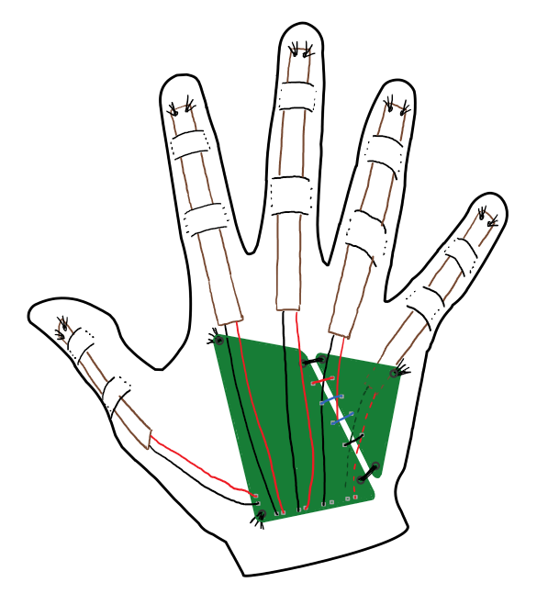
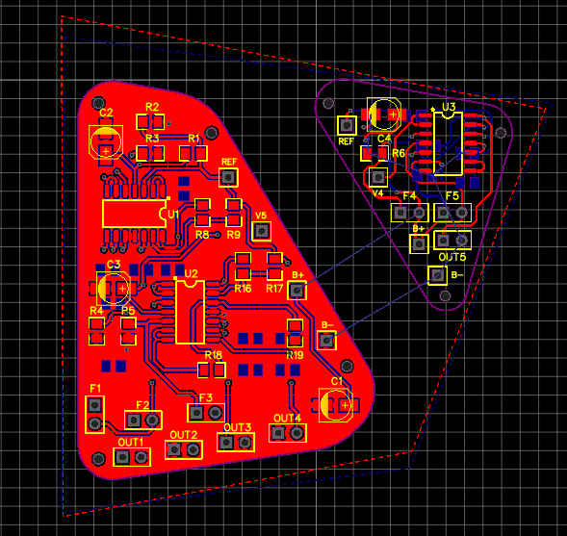
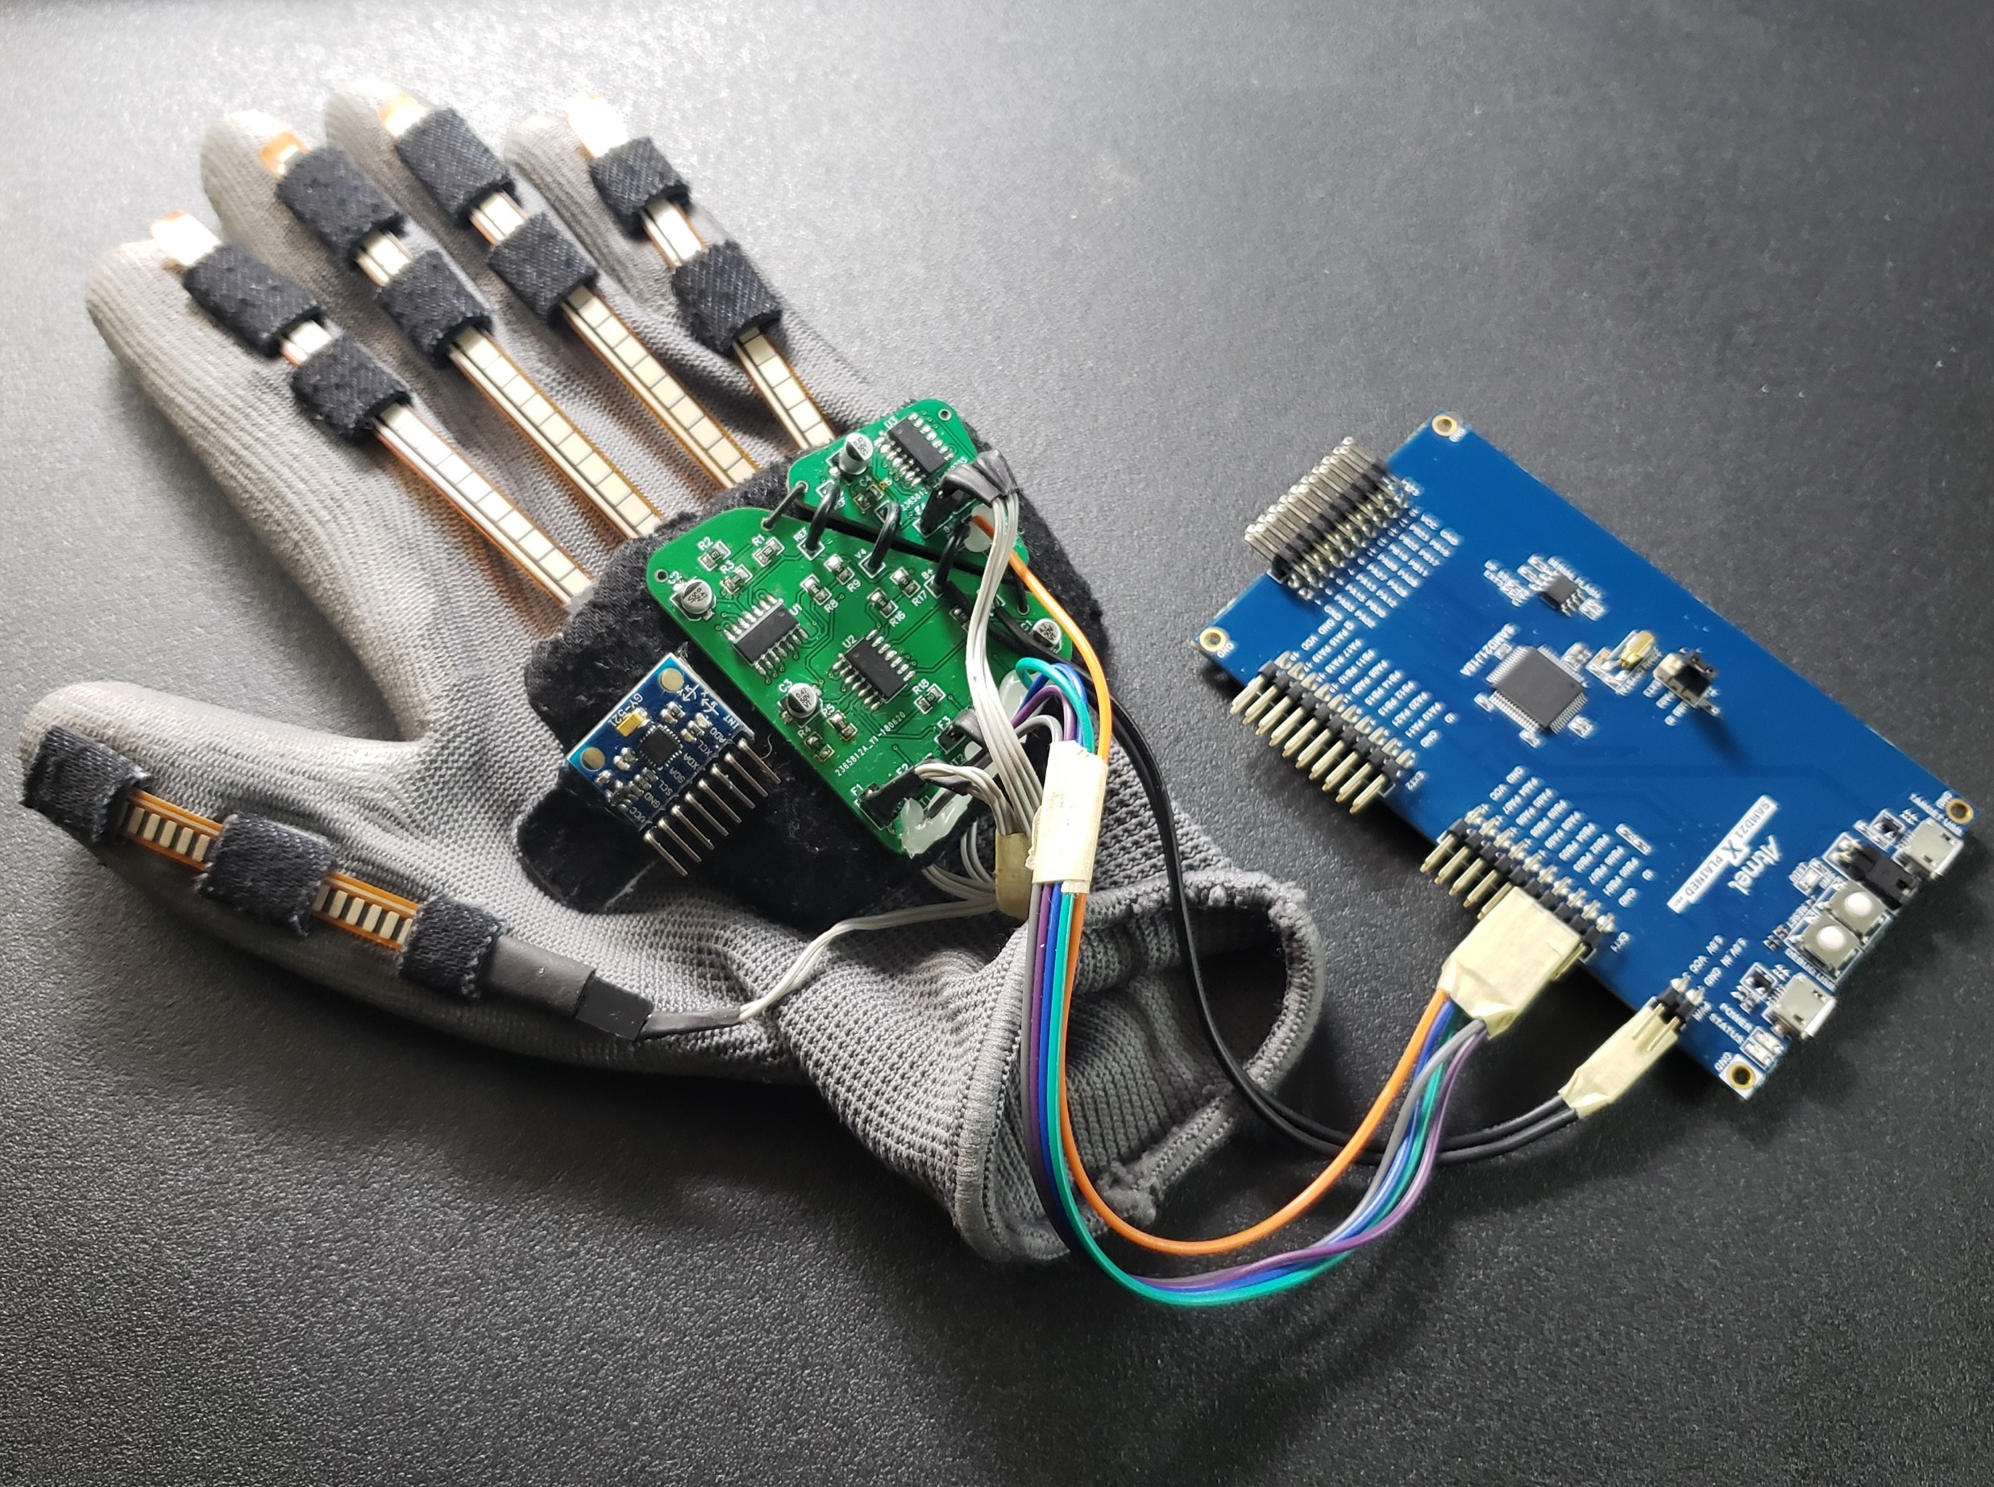
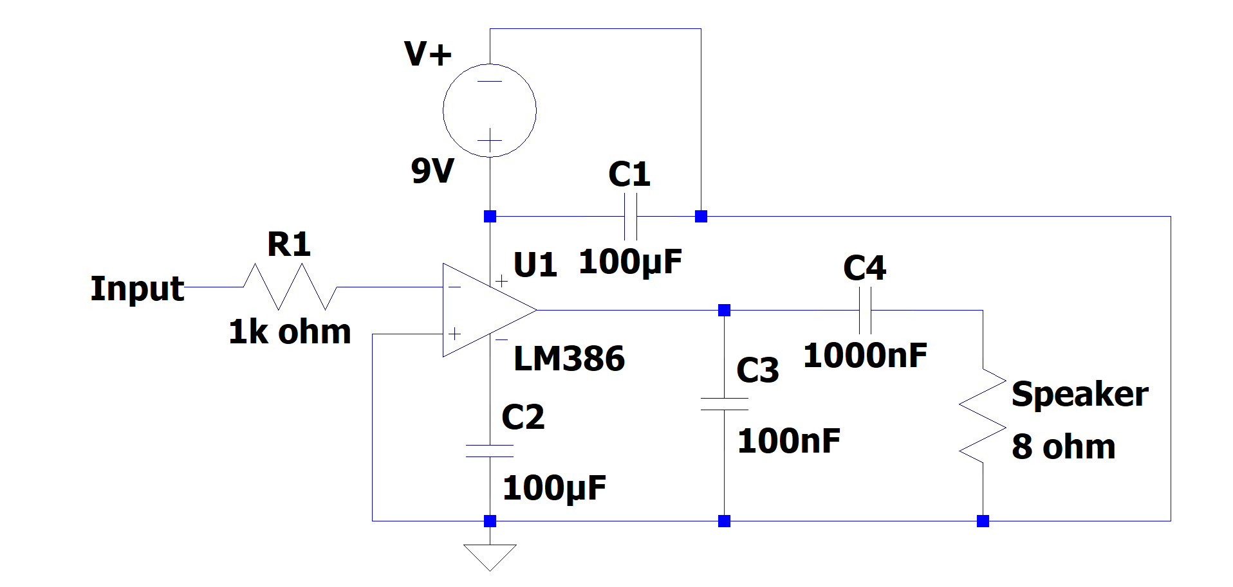
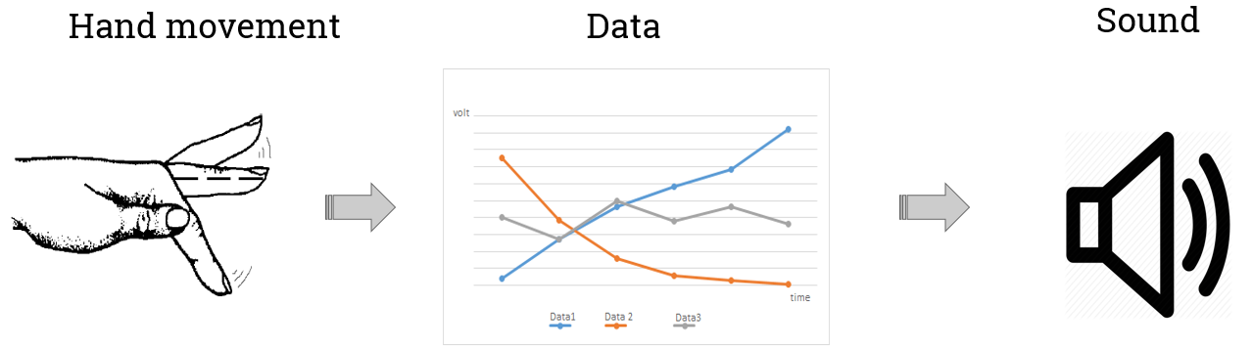
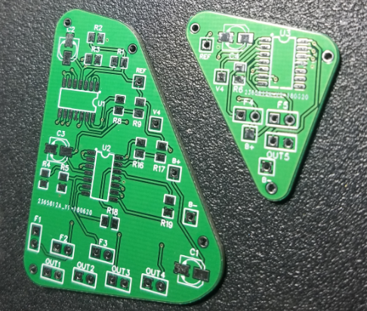

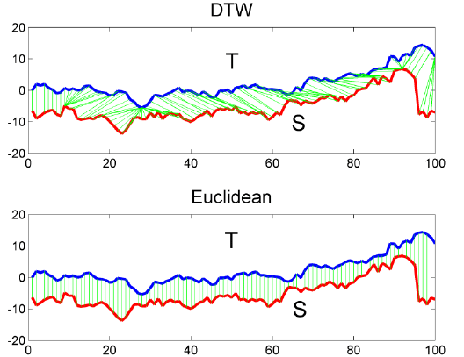
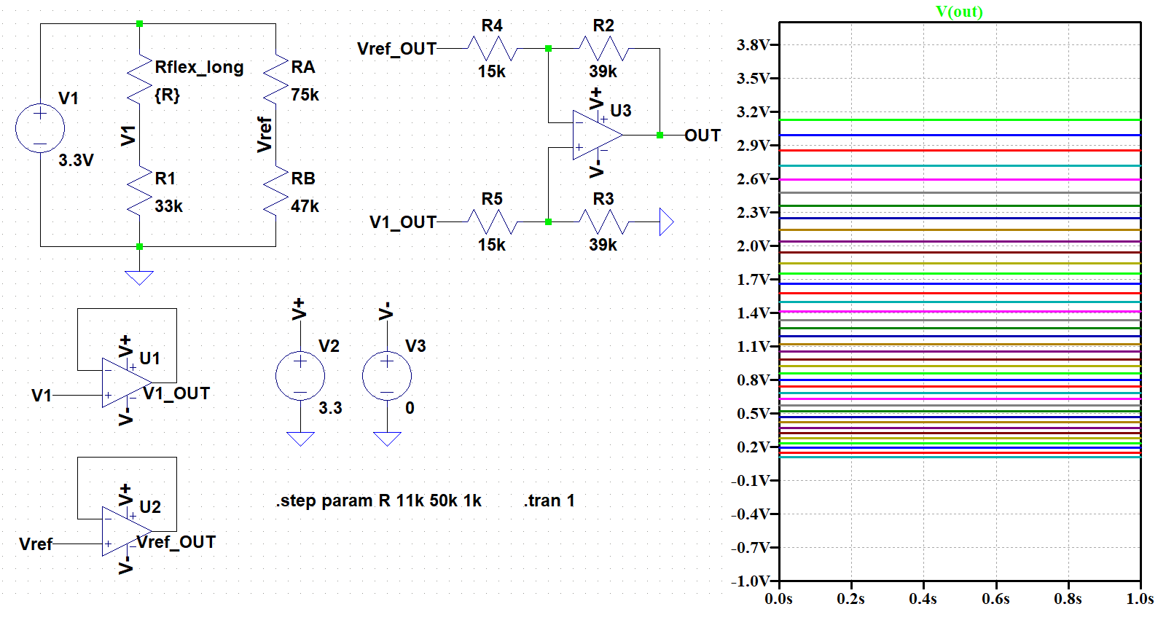
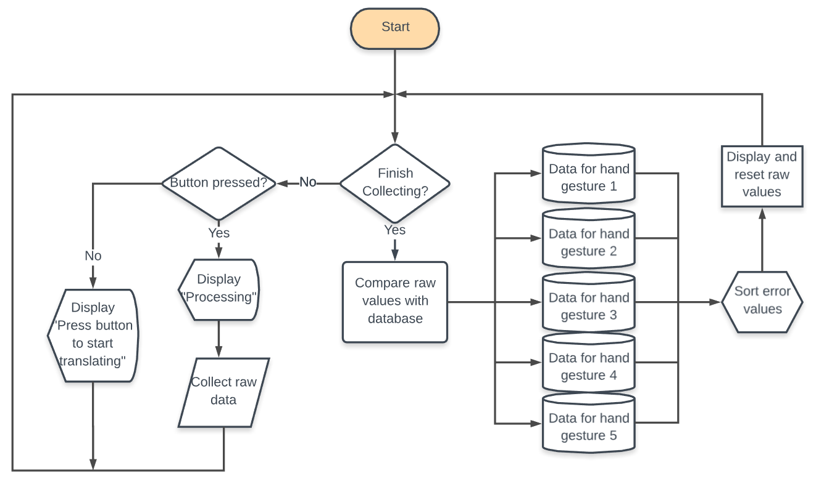
Hand Gesture to Voice Conversion Device
Duy Cu, Steven Lianto, Yiu Fai Leung
Project Advisor: Dr. Ping Hsu
Department of Electrical Engineering, San Jose State University, San Jose, California 95192
Methodology
Voice output:
The voice outputs are pre-recorded and stored in the form of C array in the memory of the microcontroller. These C arrays are digital signals that represent different words the system can output. Once the system identify the input, the result will be linked to the corresponding C array and then converted back to analog signal (voice) using DAC on the microcontroller.
Results
Introduction
Methodology
In this project, we will translate American Sign Language (ASL) into vocal or text. The device consists of 5 flex sensors which are connected to an analog circuit, an ATSAMD20J18 microcontroller unit (MCU), a fiber glove, and a speaker. The analog circuit itself consists of an LM324 OPAMP, and a few passive electronic components.
The circuit is implemented using a EasyEDA software. Figure 3 shows the footprint of the circuit for the flex sensors. The board is design using 2 layer: top and bottom layer. By using surface mount design, we were able to reduce the circuit’s size and reduce the cost for the materials. Some PCB design considerations are: minimum width of trace, and bulk and local capacitor
Figure 1 briefly explain how this device work.The way this device works is by collecting data points from finger bend. Then, it will compute and match them with one of the five hand gestures’ reference data. The sampling process will only run for two seconds and collect a total of 1000 data points (200 from each flex sensors). The matching algorithm we used for this project is a simple distance calculation. The distance that gives less value will be the result that matches the reference hand gesture data.
Figure 1: A simple illustration on how the device works
Figure 3: PCB layout design
Peripherals used in the SAM D20 microcontroller:
The reason we chose ATSAMD20J18 is because the MCU allows us to run multiple timer counters, Analog to Digital and Digital to Analog conversion (ADC and DAC) and serial communications (SERCOMs). The MCU can hold up to 256 kB of data in its in-system self-programmable flash memory.
Pattern Matching:
One of the biggest challenge of our design is to identify different signs.
The idea behind our pattern matching method is to consider the data points collected from the sensors in certain time frame as an array or a vector. There are arrays stored in MCU that represent how the users should bend their fingers or move their hand to represent certain meaning. The equation shown in Equation 1 is used to compare the input arrays and the arrays in the database. The one with the lowest discrepancy is considered to be the match.
Equation 1: Equation to calculate the error between 2 signals
Signal 1 Distance
Signal 2
Figure 4: The comparison of DTW vs Euclidean method when computing the error
Figure 5: Amplifying Circuit for Speaker
Figure 8: Final result
Results
Summary
The result of the PCB design is shown in Figure 6. The minimum width was set to 0.3mm because the current will always be less than 1A. Bulk and local capacitors are placed near the power supply to reduce noise for our circuit. The diameter for the through-hole is set to be the standard 0.9mm.
The device and the pattern matching algorithm were successfully built and programmed. Because of limitations of the flash memory on the SAM D20, we were not able to store all the voice file for the speaker to read from. The glove device could distinguish between 5 different hand gestures, which are: Yes, No, Okay, Hard of Hearing, and Thank You. Some of the biggest problem that was encountered are: getting USART to communicate through the micro-USB, configuring the MPU-6050 to operate in Atmel software, physical wire connection stability, and not enough flash memory to store all data.
Methodology
Figure 6: Printed PCB board
Atmel Studio 7 is the software we used for testing and debugging our software. We start with one of the example project that uses USART peripheral. This allow us to communicate back via terminal for easy debugging. The timer counter peripherals is used as a periodic interrupt that calls a function to sample the raw data.This function will utilize the ADC peripherals to read the input voltage from five flex circuit. Once the sampling is finished, the SAM D20 will blinking one of the LED to notify the user that it is finished. Figure 7 show the logic diagram flow of our software
Flex circuit design:
The design for the circuit from LTspice for the flex sensors is shown in Figure 2. Our objective for this circuit design is to convert a resistance change from the flex sensors into a change in voltage. The circuit will include a voltage division, buffer, and a gain stage. The buffer circuit is required in this design because it prevent low impedance affecting the voltage level (divider effect). The output will cover a range between 0 - 3.3V for the microcontroller to read from.
Figure 2: Schematic of the flex-reading analog circuit
Key References
[1] A novel array of flex sensors for a goniometric glove. (2013, November 07). Retrieved from https://www.sciencedirect.com/science/article/pii/S0924424713005451
[2] Bukhari, JanFizza & Rehman, Maryam & Ishtiaq Malik, Saman & Kamboh, Awais & Salman, Ahmad. (2015). American Sign Language Translation through Sensory Glove; SignSpeak. International Journal of u- and e-Service, Science and Technology. 8. 131-142. 10.14257/ijunesst.2015.8.1.12.
[3] N. Praveen, N. Karanth and M. S. Megha, "Sign language interpreter using a smart glove," 2014 International Conference on Advances in Electronics Computers and Communications, Bangalore, 2014, pp. 1-5.
doi: 10.1109/ICAECC.2014.7002401
Amplitude
Time
Amplitude
Acknowledgements
Time
We thank Professor Ping Hsu for helping designing the PCB, Dr. David Parent for helping with circuit design, and Christopher Pham for embedded developing. We also want to thank Atmel for providing intuitive developing software and their example project. We also want to thank the Engineering building for allowing us using their testing equipments.
Figure 7: Logic flow diagram

